Slide 1
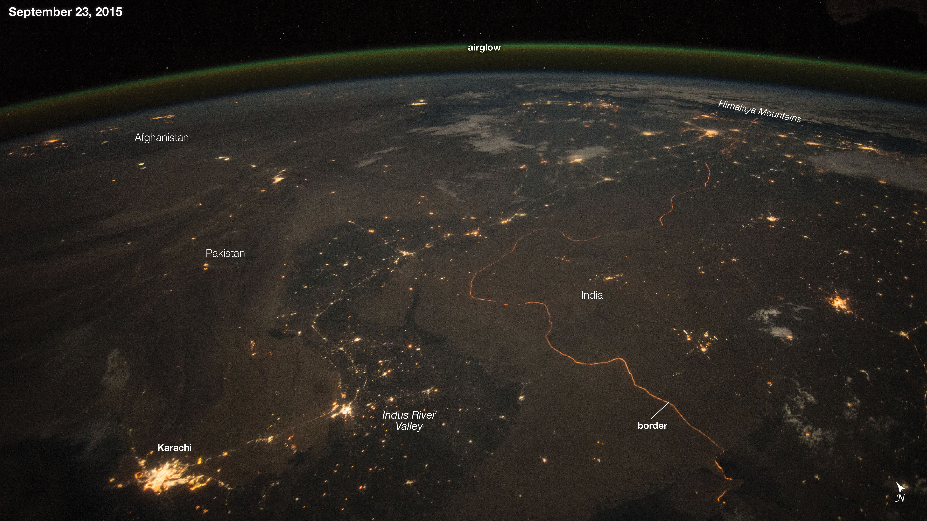
Shortest Path Problem
Syed Hammad Ali
Muhammad Salman Abid
Syed Muhammad Ammar Alam
Agha Syed Nasir Mahmood Azeemi
Image Credits: NASA

Slide 2
References
1. Highway Dimension, Shortest Paths, and Provably Efficient Algorithms Ittai Abraham∗ , Amos Fiat† , Andrew V. Goldberg‡ , Renato F. Werneck§
2. https://drivethruhistoryadventures.com/roads-roman-empire/

Slide 3
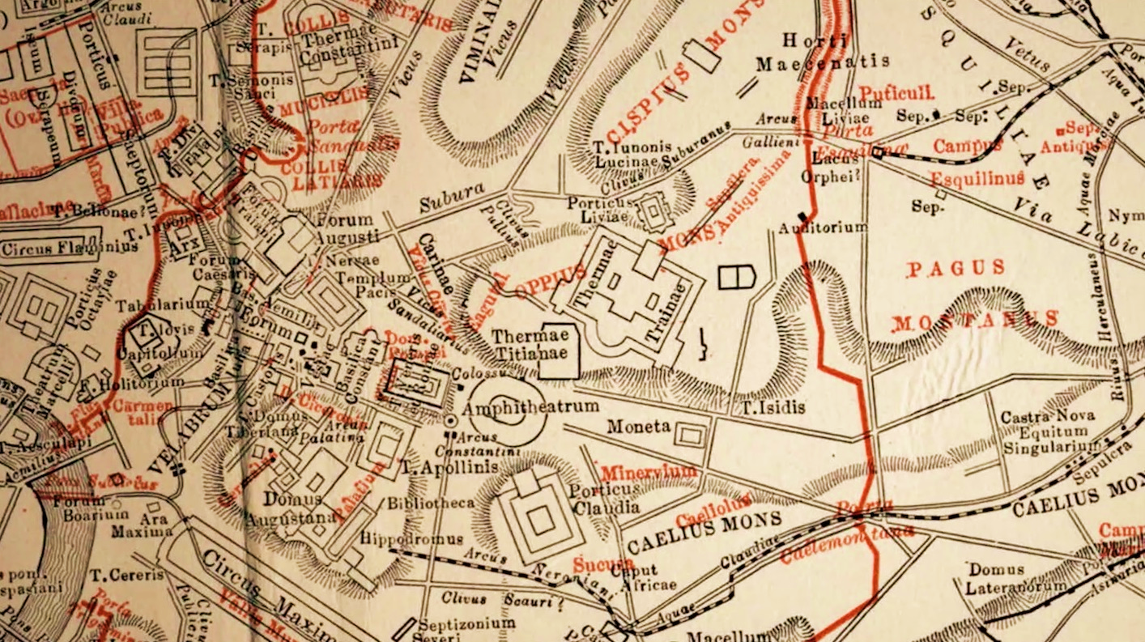
il problema
The most popular problem throughout history
Romans built huge road networks with milestones
Mapping the ‘world’ was hard…
Still unclear how the Romans computed shortest paths
Image Credits: drivethruhistoryadventures.com
Notes:
Julius Caesar and Mark Anthony
32 years to map the world
1. Highway Dimension, Shortest Paths, and Provably Efficient Algorithms Ittai Abraham∗ , Amos Fiat† , Andrew V. Goldberg‡ , Renato F. Werneck§
2. https://drivethruhistoryadventures.com/roads-roman-empire/

Slide 4
uSES
Strategic planning and construction of road networks
Optimization Problems in Computer Science
Airline Ticketing systems
Self-Driving Cars
Maps
Basically if it can be modelled as a graph…

Slide 5
The Algorithms
Best-First Search (Informed Search)
Dijkstra's Algorithm
Bellman-Ford algorithm
A* search

Slide 6
Best-first algorithm - Theory
Greedy Approach
Based on Heuristics
Complexity - O(|V|log(|V|))
Does not work for negative weights
Does not guarantee shortest path

Slide 7
Best-First Search
Also called Informed Search
A smarter version of the Breadth-First search
An evaluation function f(n) is used as the heuristic
The heuristic is used to determine the adjacent node most promising
Keyword: Promising (i.e. does not guarantee)
Notes:
Heuristic: An indicator/metric used as an estimate to the distance to the goal node

Slide 8
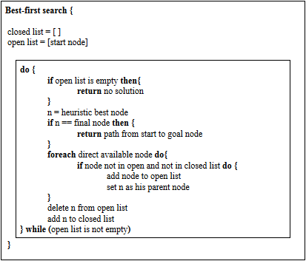
Best-first algorithm - pseudocode
Notes:
Zaharija, Goran & Mladenovic, Sasa & Dunić, Stefan. (2017). Cognitive Agents and Learning Problems. International Journal of Intelligent Systems and Applications. 9. 1-7. 10.5815/ijisa.2017.03.01.

Slide 9
Dijkstra's algorithm - Theory
Greedy Algorithm
Complexity - O(|V|*LOG(|E|)) for Adj. List
Complexity - O(|V|*|V|) for Adj. Matrix
Cannot catch negative cycles
May work for negative edges

Slide 10
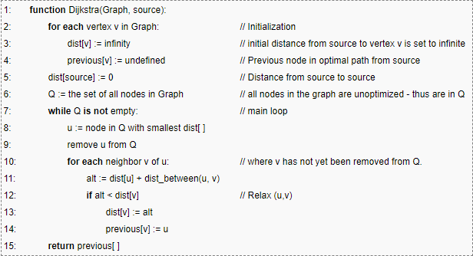
Dijkstra's algorithm - pseudocode

Slide 11
BellMan-ford algorithm - Theory
Non-Greedy Algorithm
Runs at most |V|-1 times
Complexity - O(|V|*|E|)
Can work on negative edges
Can catch negative cycles

Slide 12
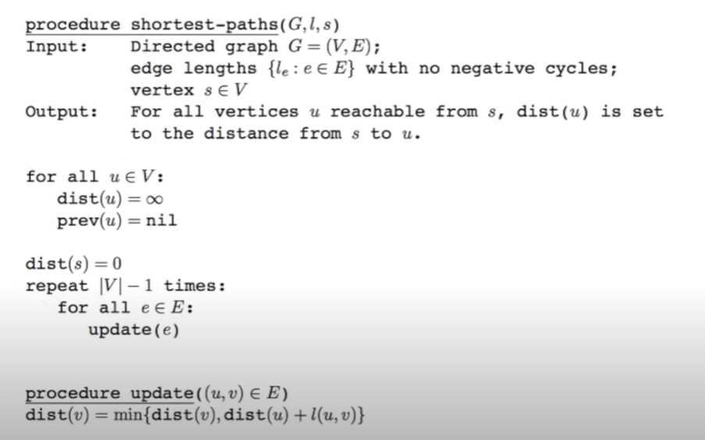
Bellman-ford algorithm - pseudocode

Slide 13
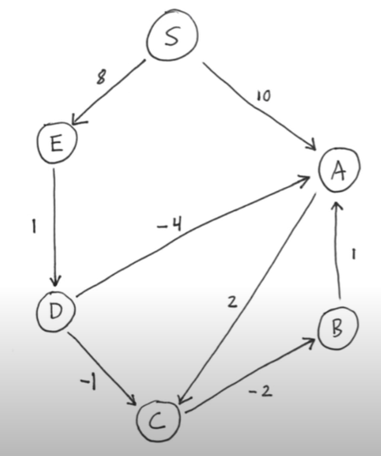
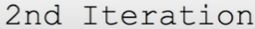
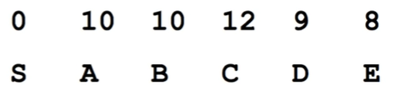
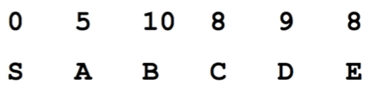
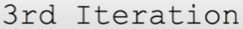
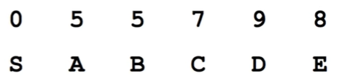
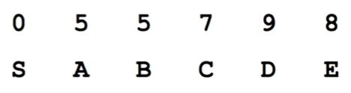
Bellman-ford algorithm – step by step
S | A | B | C | D | E
0 | 10 | ∞ | ∞ | ∞ | 8

Slide 14
A* ALGORITHM -THEORY
Non-Greedy Algorithm
Complexity - O(|E|)
Cannot work on negative edges
Guarantees shortest path
Uses Heuristics
Lesser cost than Djikstra if consistent heuristic

Slide 15
A* Algorithm
An informed-search algorithm
Non-Greedy version of Best-First
Estimates the cost of the entire path while evaluating each node
F(n) = g(n) + h(n)
If h(n) is admissible, finding the least-cost path is guaranteed.

Slide 16
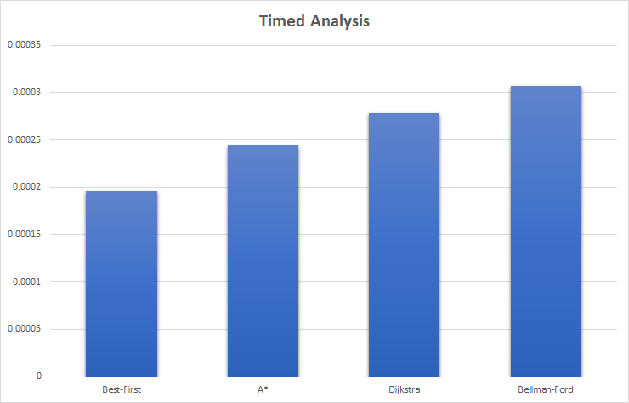
Empirical Analysis

